Slide 1
COMPANY DATABASE WEBSITE
<h1> Aziz 阿吉兹 </h1>

Slide 2
ACKNOWLEDGEMENT

Slide 3

HELLO! I’m…
<p> Aziz and today I’m going to showacase for you my final project in database principales </p>

Slide 4
TABLE OF CONTENTS.
01
02
03
04
05
06
We will talk about the purpose of this project.
We will talk about why I choose this project.
Then, we will talk about the technologies I used.
After that we will talk about the final functions.
We will also talk about how this project could be extended for further research.
And I will demonstrate how the the app works lastly.

Slide 5
WE WILL TALK ABOUT THE PURPOSE OF THE PROJECT
01

Slide 6
HELP COMPANIES
<p> Companies have complicated structures so sometimes it becomes impossible to manages its data. So this website helps those companies to make their work more easy</p>

Slide 7
NOW WE WILL TALK ABOUT WHY I CHOOSE THIS PROJECT
02

Slide 8


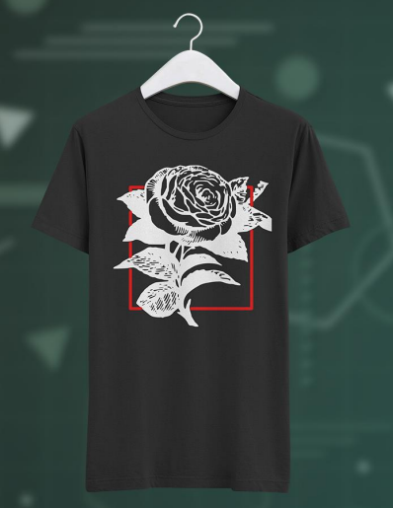
GRAPHIC DESIGN BACKGROUND

Slide 9

WEB DEVELOPMENT CAREER

Slide 10
NOW WE WILL TALK ABOUT THE TECHNOLOGIES
03

Slide 11
The main Technologies I used are:
PHP
HTML
CSS & bootstrap
link my database to website and run php commands to run SQL commands
UI for the queries and the functions from the SQL code
make the cool designs in the website. The HTML elements are from bootstrap.
SQL
WAMP Server
PhpMyAdmin
to create the database for the Company.
Create a web app with php, MySQL and links it all together.
Management of the database in an easy way.

Slide 12
WE WILL TALK ABOUT THE FINAL FUNCTIONS
04

Slide 13
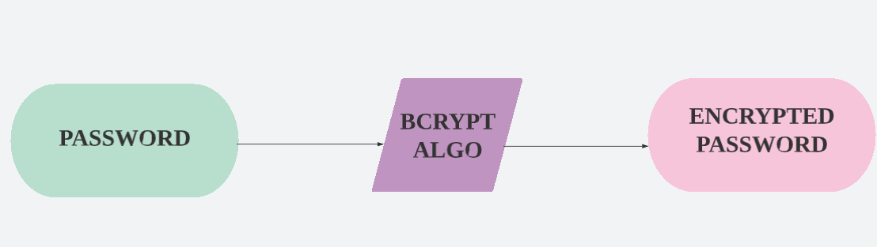
Authentication
So to protect the users from hackers and the database in general. I choose to use an encryption in the password and use the password hash function from the php.
Bcryption stands for blow fish encryption and it is a strong algorithm to hash the password. For example the user types the word hello. We take it in the backend and make go through the algoirthm of hashing and then store it in the database.

Slide 14
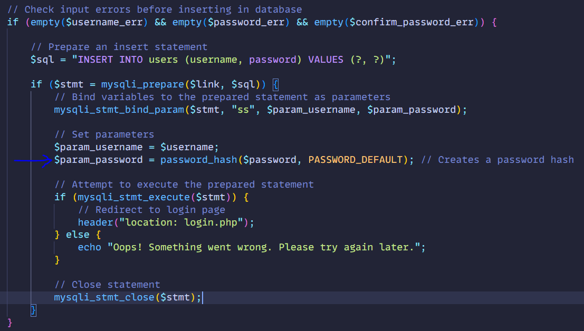
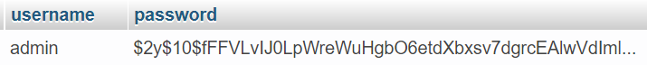
Code Snippet:
We are using PASSWORD_DEFAULT function provided by php documentation, to create the hash for the password.

Slide 15
CRUD PHP
CREATE & UPDATE
READ
DELETE

Slide 16
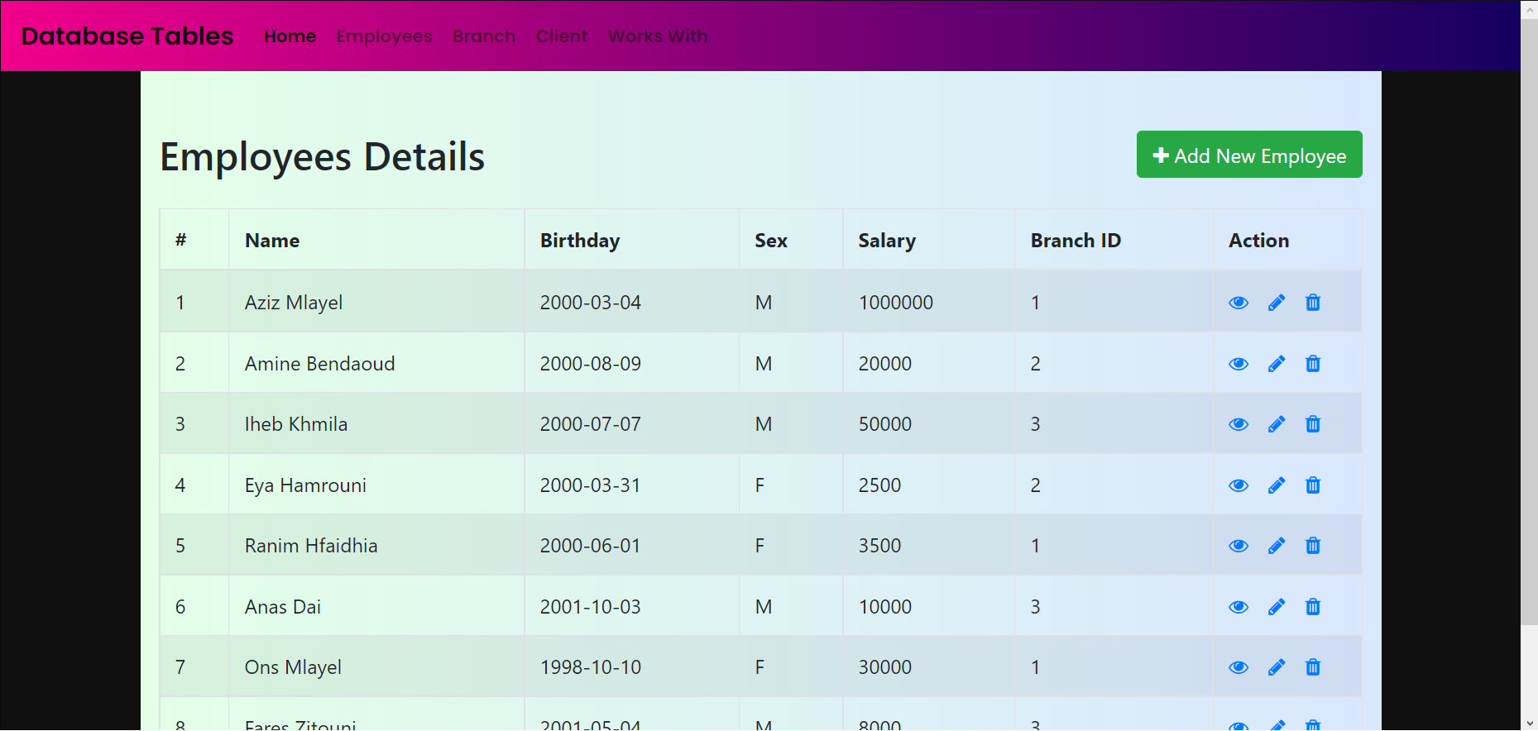
Screenshot from the website
CREATE & UPDATE
For create we use the Add New Employee Button
For Update we use the button with pen icon

Slide 17
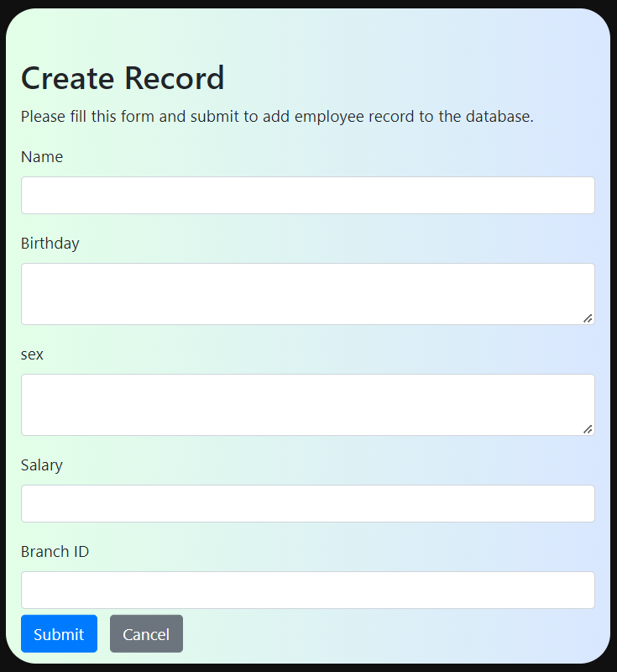
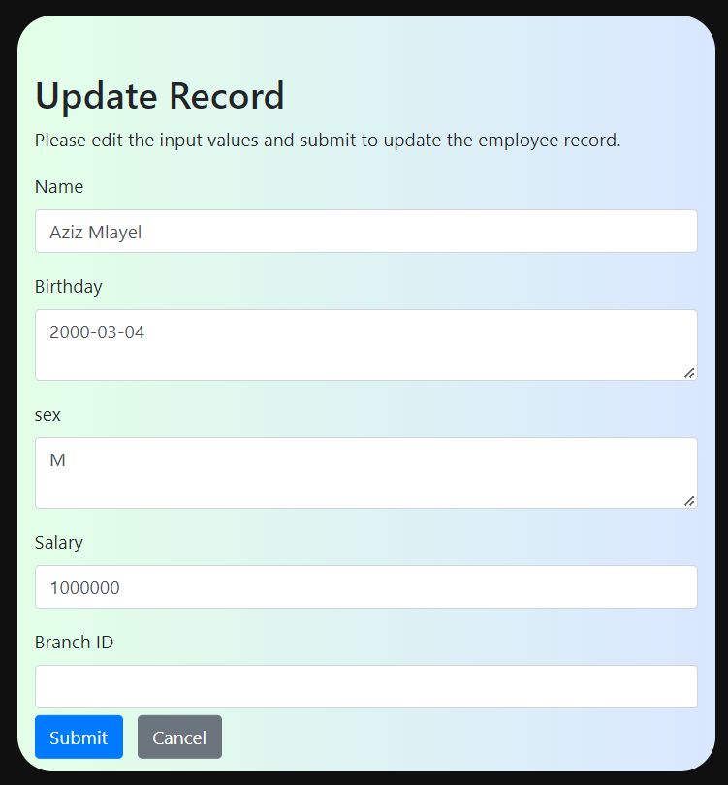

Screenshot from the website
CREATE & UPDATE
For create we use the form with user input validation to be protected for wrong input and SQL injection New Employee Button. After that we run SQL INSERT code to put it in the database
For Update is the same as Create
SQL injection usually occurs when you ask a user for input and instead of a name/id, the user gives you an SQL statement that you will unknowingly run on your database.

Slide 18
Screenshot from the website
READ
For read we use the eye button

Slide 19
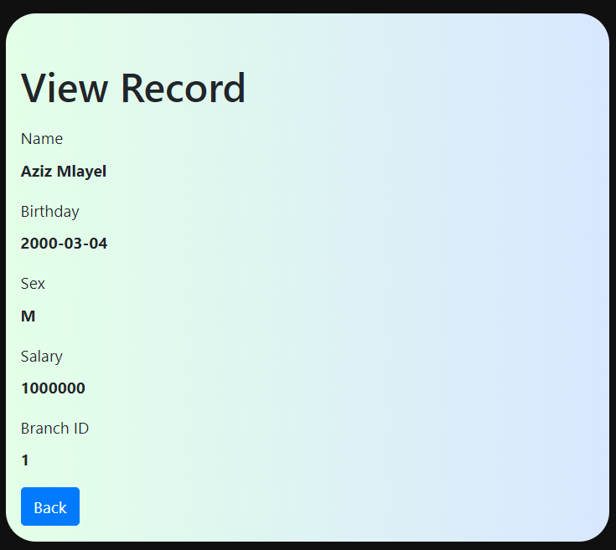
Screenshot from the website
READ
For read function we just need to take the Employee id from the table and run SQL code to query that id and showcase all the data that he has

Slide 20
Screenshot from the website
DELETE
For DELETE we use the trash icon button

Slide 21
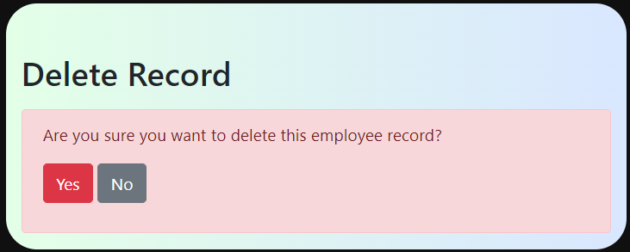
Screenshot from the website
DELETE
When the delete button is pressed the user is asked are you sure? I made this because accidents happen and the user could press the button in accident. We take the Employee Id from where the user pressed and then we delete it from the table with SQL DELETE code

Slide 22
NOW WE WILL TALK ABOUT FURTHER RESEARCH
05

Slide 23
FURTHER RESEARCH
BACK-END
FRONT-END
Add Animation
Fix display settings for phone view
Add 3D elements to make the modern design
Have a designated Color Palette
Organize the Fonts
DATABASE
Strengthen the Authentication
Better Code Management
We can more Tables to make the work flow more clear
More SQL commands for visualizing the data

Slide 24
NOW I WILL SHOWACASE THE WEB APP
06

Slide 25

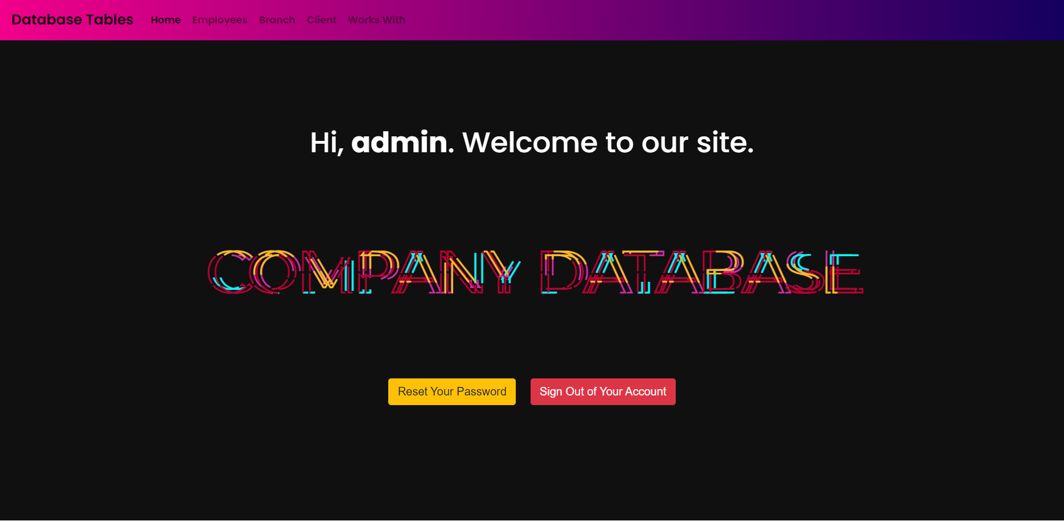
WEBSITE DESIGN

Slide 26
THANK YOU!
Aziz.Mlayel16@gmail.com
Do you have any questions?

Slide 27
CREDITS.
Presentation Template: SlidesMania
Fonts used in this presentation: Roboto Mono and Roboto Bold

